Slide 1
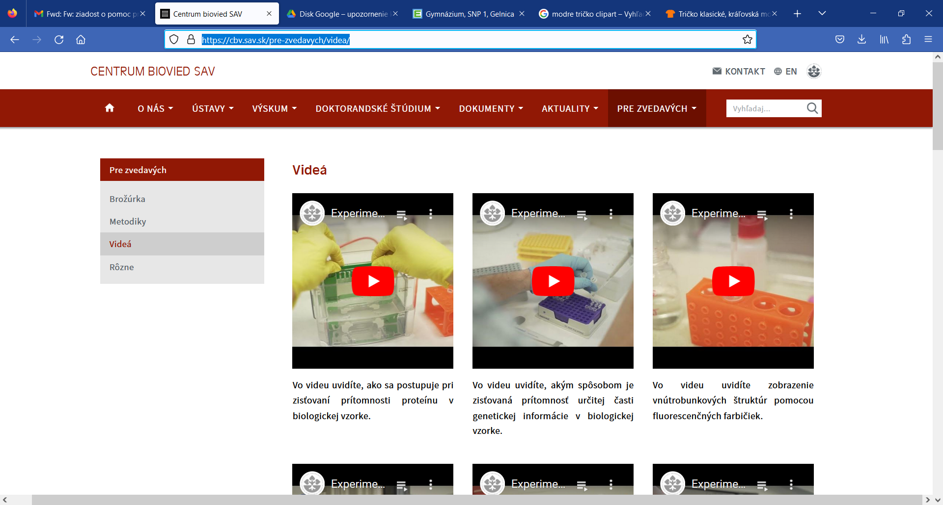
https://cbv.sav.sk/pre-zvedavych/videa/

